Slide 1
Capstone Project - Restaurant in Belgrade

Slide 2
Parts of presentation
- Introduction/Business Problem
- Data
- Analysis
- Results

Slide 3
Introduction/Business Problem and Data
Introduction/Business Problem
As there so many restaurants in Belgrade risk for opening new restaurant is getting bigger. That’s why using data science and location data of other restaurants we can reduce that risk and help small business owners to open new restaurants.
Data
Using Foursquare API we will gather all required data we need for finding the best location for the new restaurant.
For our project, we will gather the name of the restaurant, address, and geographical coordinates and that data will be used for analysis.

Slide 4
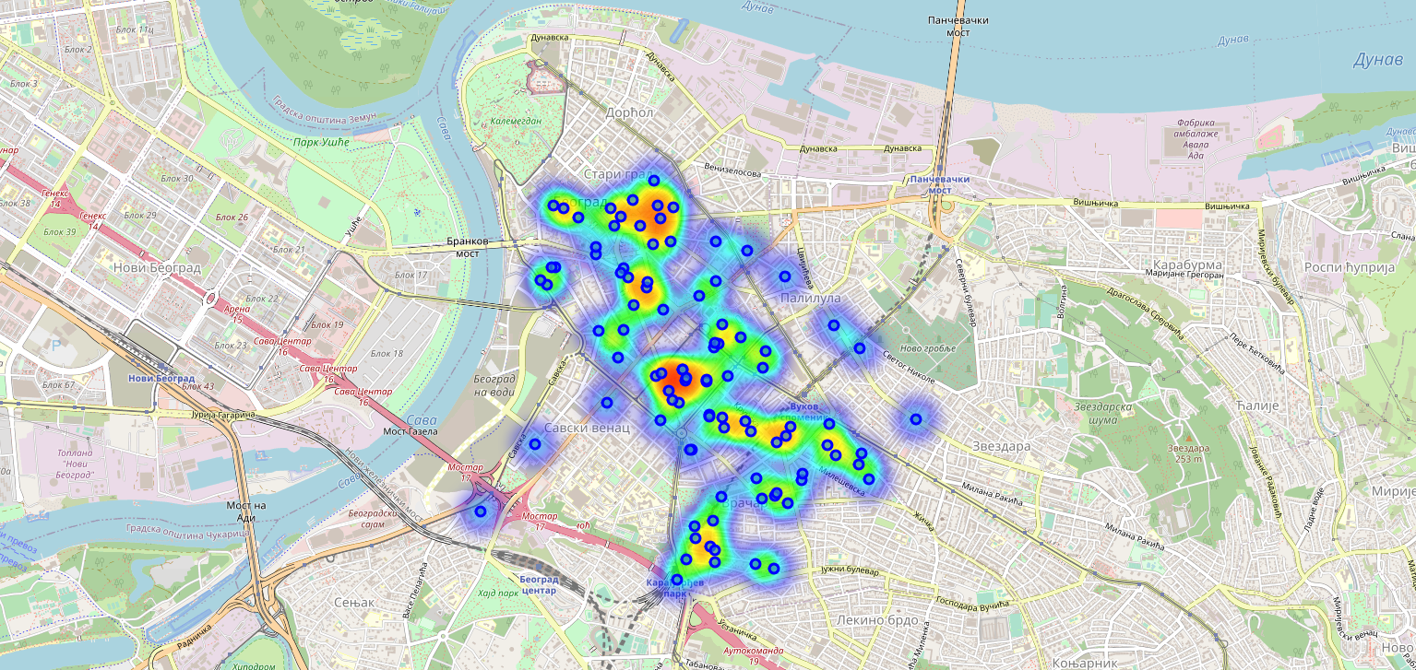
Analysis and Results
Analysis
Data gathered using Foursquare API
Clean data and retrieve only restaurants data from dataset
Show data on map
Results
With map we easily see what part of city is crowded with restaurants and with that in mind it easier for new business owner to choose location for new restaurant.

Slide 5
THANK YOU

